Slide 1

Computer Vision for Enhanced Gameplay: Image Recognition and Gesture Analysis
James Bianco & Daren Scerri
Institute of Information & Communication Technology
MCAST, Paola, Malta

Slide 2
Problem Definition
Background
In gaming, no console or pc uses camera as a controller.
Any tests previously made, were used on static images or cameras with the same angle and lighting.
Aim of Study
Using computer vision & image classification, to test if it is possible to use hand gestures as a means of controlling the user’s actions.
Objectives
Develop a program that reads the user’s hand signs and predicts which hand sign the user is displaying.
Evaluate the difference in confidence the program has if camera angle and/or lighting is changed.

Slide 3
Hypothesis & Questions
Hypothesis
The hypothesis of this research is that every person that uses a computer and a camera uses different lighting and camera angles throughout the day, alongside possibly having other objects in the background. This will result in the computer having a harder time identifying what it is looking at, resulting in a lower confidence percentage and therefore taking a larger amount of time to identify objects in the camera view.
Research Questions
Is it possible to use computer vision and image classification with games as a new means of controlling certain actions in-game?
How much of a difference in confidence does different lighting and angle make on a computer trained with a clean dataset?
Notes:
Therefore, this research intends to focus on the recognition and catering of accents within the English spoken language and we hypothesise that…
To address the hypothesis, we ask these 3 research questions to identify the determining factors of accents and how ASR can be enhanced with our research

Slide 4
Literature
Computer Vision
A task that uses an algorithm and optical sensors to acquire, process, analyse and understand digital imagery and is used to extract high-dimensional data from the real world to be able to produce numerical or symbolic information. (Klette, 2014)
Image Classification
Ability to predict a semantic concept based on the visual concept of an image. (Durand et al., 2013)
Traditionally done by low-level or mid-level methods to represent an image. Low-level features based on grayscale density, color, texture, shape and position information, which are defined by a human. Mid-level and learning-based features are then commonly distilled by algorithms, which have been used in image classification or retrieval framework in the past few years. (Mohammed, 2022)

Slide 5
Methodology
Develop a program that reads the user’s hand signs .
Save the hand signs and train a model.
Experiment with the model after the training using different angles and lighting.
Evaluate the difference in confidence the program has if camera angle and/or lighting is changed.

Slide 6
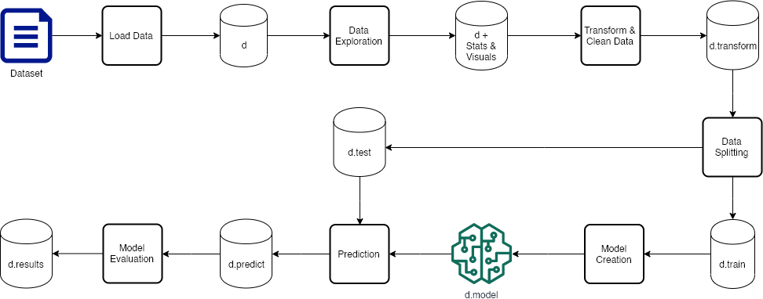
Pipeline Diagram

Slide 7
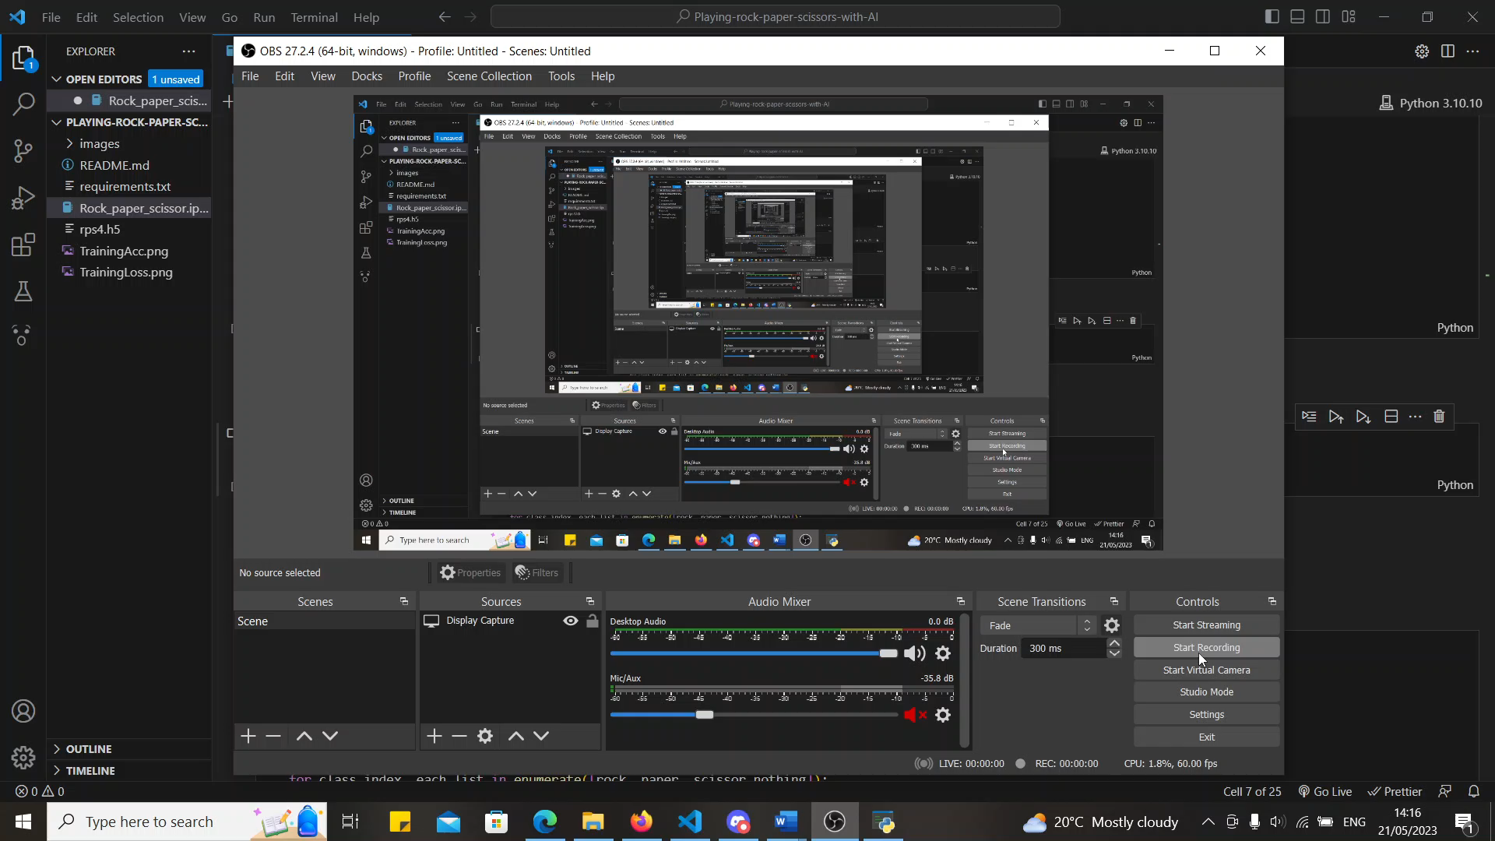
Prototype demonstration – Gathering of dataset images

Slide 8
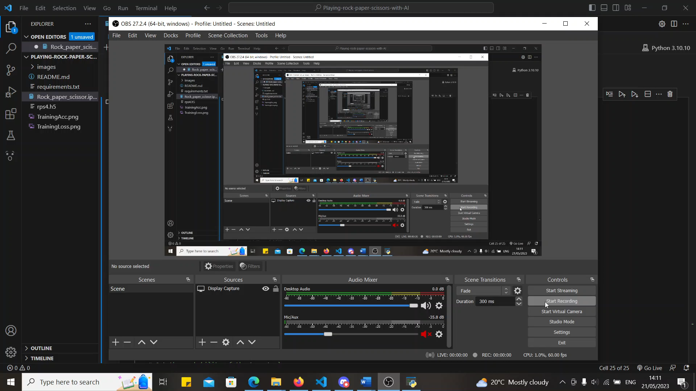
Prototype demonstration – Testing of camera & lighting

Slide 9
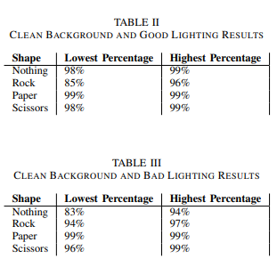
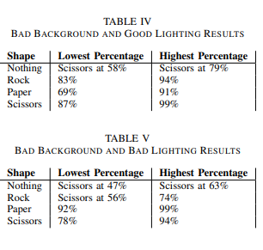
Results

Slide 10
Conclusions
Hypothesis: Hand signs could be used as a means of controlling the actions in a game with further research needed.
Performance was drastically low with low frame-rate & delay in camera.
Physically straining raising arm for computer’s vision.
Noted that results with bad background and bad lighting result in worst confidence in computer.
Distance from the camera and camera angle impacts accuracy drastically.
Some results suffer from being read as another shape.

Slide 11
Improvements/Future Recommendations
Use a better angle for ease of use for arm.
Further testing by using bad background and lighting in model & test with clean background and lighting.
Similar project with a high-end computer.

Slide 12
References
R. Klette, “Concise computer vision,” Undergraduate Topics in Computer Science, 2014
T. Durand, N. Thome, M. Cord, and S. Avila, “Image classification using object detectors,” in 2013 IEEE International Conference on Image Processing, 2013, pp. 4340–4344
A. Mohamed, A. Hemeida, and M. Hassan, “Image classification based deep learning: A review,” Aswan University Journal of Sciences and Technology, vol. 2, 06 2022.

Slide 13
Thank you James Bianco, Daren Scerri

